Slide 1
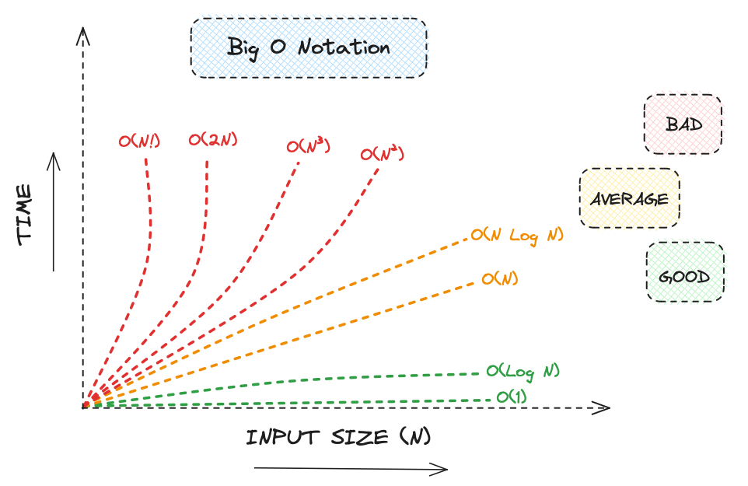
M02 L08 Algorithm Analysis and Big O

Slide 2
Today
Check In
Quiz and Tech Doc
Goals
Explain what Big-O notation means in plain language and identify what n represents.
Compare algorithm growth rates (O(1), O(log n), O(n), O(n²)) using simple examples and analogies.
Analyze step counts in sorting and searching algorithms to see how they connect to Big-O.
Differentiate between best, worst, and average cases for searching and sorting algorithms.
Evaluate tradeoffs in time and space when choosing an algorithm for a given problem.
CS50x 2024 - Lecture 0 - Scratch
It starts at 51:47
Thanks Raina

Slide 3
Quiz and Technical Documentation
Reviewing Lectures from module 1
practice code
Explain concepts using correct terminology
Retry Guided Exploration
Update technical documentation - It can contain information from module 1 and module 2 but the quiz is on module 1.
Bring your printed technical document
There will not be any questions about Eclipse, git or github.
Make sure you name is on your printed documentation as you will hand it in with your quiz.
If it contains AI generated information or my slides as your work your quiz will be a 0
The exam is 50 points containing
Part 1: TF 12pts
Part 2: Multiple Choice 12 pts
Part 3: Fill In Output 6 pts
Part 4: Write Code 10 pts
Part 5: Explain 10pts

Slide 4
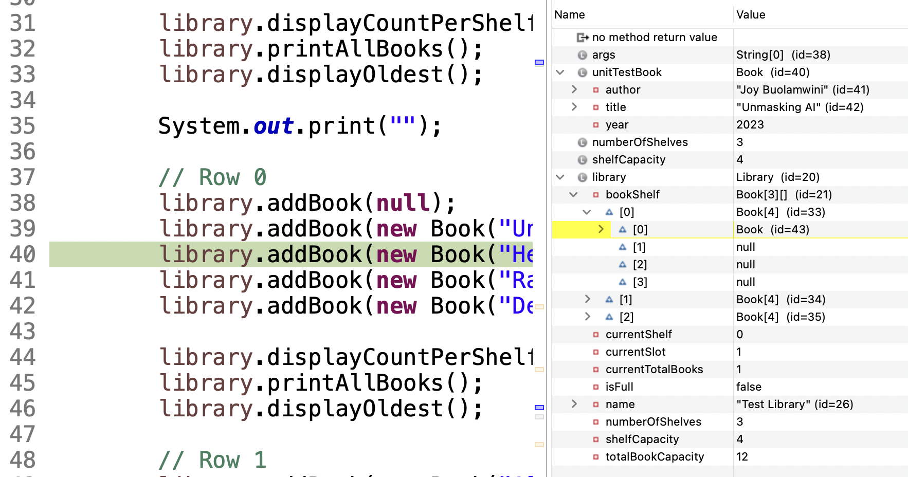
Quiz Discussion
Look at the objectives from module 1 and GE some things you did in GE M01.
Predict what I might ask you to do on the Module 1 exam.
Ask questions about something that didn’t make sense from module 1.
Open your Eclipse and run debugger for your Library App
How is information stored in memory? Stack? Heap? Static variables?

Slide 5
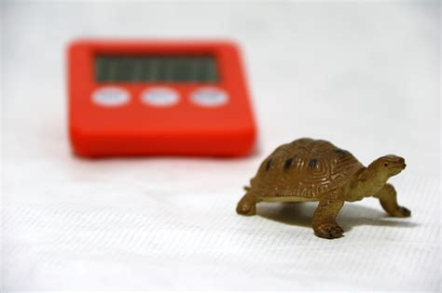
Rating Algorithms
Why does one search feel instant and another take forever?
Some algorithms are faster than others.
We want a way to measure speed that doesn’t depend on the computer.
Big-O = a rating system for algorithms.
What is the difference between linear graphs and quadratic graphs?

Slide 6
Big-O
A theoretical approach for analyzing algorithms independent of computers and specific input.
Estimates algorithm time complexity
Classifies the upper-bound (worst case) time behavior of an algorithm
Estimates change in execution time based on input size
Gives us a growth rate – use to compare algorithms
How fast an algorithm’s execution time increases as the input size increases
Easy way to think of Big-O
A rating system for algorithms.
The rating (Big-O) tells you how fast you can expect the algorithm to be as the number of inputs gets larger and larger.
Now you can compare algorithms based on their ratings like we do so many things in life!

Slide 7
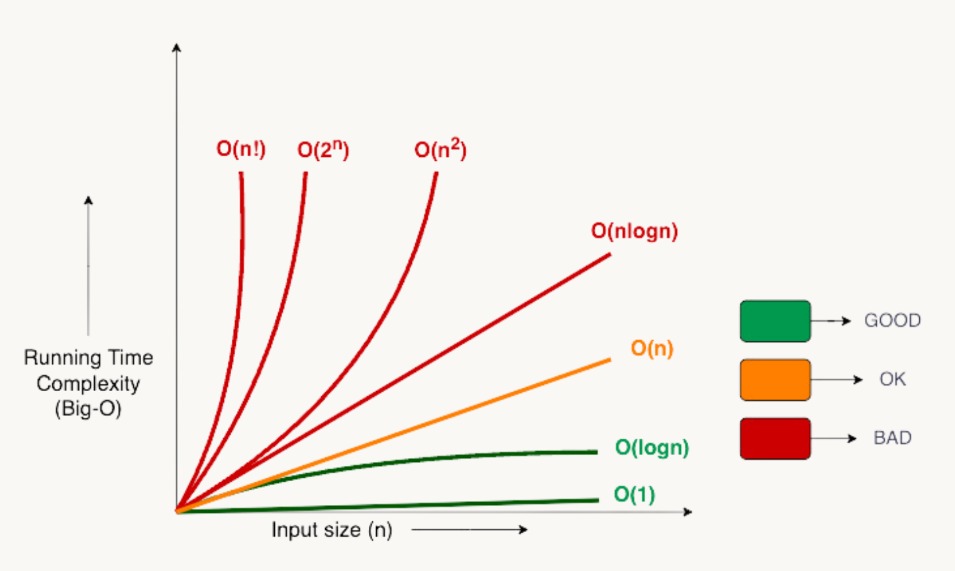
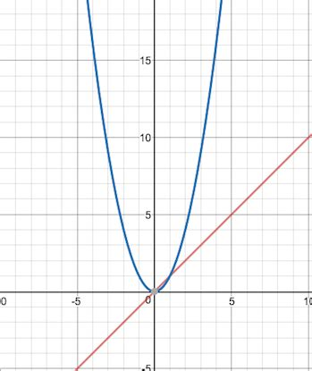
Big-O Symbols
O( ) = “order of” = how the steps grow as input grows.
n = the size of the input (number of items).
Examples Best to Worst:
O(1) → constant, 1 step
flip a light switch.
O(n) → linearly grows with input.
check every seat in a theater to find a friend.
O(log n) → grows very slowly.
guess a number 1–100 with “higher/lower.”
O(n²) → steps grow like a square.
everyone in the room shakes hands with everyone else.

Slide 8
Debug in Eclipse
What’s going on in the selection sort?
Add SortAnalysis.java
Focus on selection sort.
Put breakpoint in selection sort

Slide 9
Selection Sort Code
public static int selectionSortCount(int[] a)
{
int comparisons = 0;
for (int i = 0; i < a.length - 1; i++)
{
int minIdx = i;
for (int j = i + 1; j < a.length; j++)
{
comparisons++; // count each comparison a[j] < a[minIdx]
if (a[j] < a[minIdx])
minIdx = j;
}
if (minIdx != i)
{
int t = a[minIdx];
a[minIdx] = a[i];
a[i] = t;
}
}
return comparisons;
}
Loop executes n-1 times
Code inside loop is Code inside loop is constant. No matter what n is, one iteration of loop takes same number operations (or less)
How many times does the inner loop execute?

Slide 10
Selection Sort Analysis
Outer loop → goes through each position except the last (n-1 times).
Inner loop → scans the rest of the array to find the smallest.
Total comparisons = sum of all those inner loop runs.
Small Example (n = 5)
Outer loop runs 4 times:
Pass 1 → 4 comparisons
Pass 2 → 3 comparisons
Pass 3 → 2 comparisons
Pass 4 → 1 comparison
Total = 4 + 3 + 2 + 1 = 10 comparisons.
Larger Example (n = 10)
Pass 1 → 9 comparisons
Pass 2 → 8 comparisons … down to Pass 9 → 1 comparison
Total = 9 + 8 + 7 + … + 1 = 45 comparisons.
Pass | Comparisons (n=5) | Comparisons (n=10)
1 | 4 | 9
2 | 3 | 8
3 | 2 | 7
4 | 1 | 6
… | … | …
Total | 10 | 45

Slide 11

Selection Sort Steps and Math Pattern
For an array [8, 3, 5, 1], the steps are:
Find the smallest element → Swap it with the first element
[1, 3, 5, 8] (1 was moved to the first position)
Find the next smallest → Swap it into position
[1, 3, 5, 8] (No swap needed)
Repeat until sorted
[1, 3, 5, 8] (Already sorted)
The outer loop runs n−1 times.
The inner loop searches for the minimum in the remaining elements, making comparisons.
Total comparisons (worst case):

Slide 12
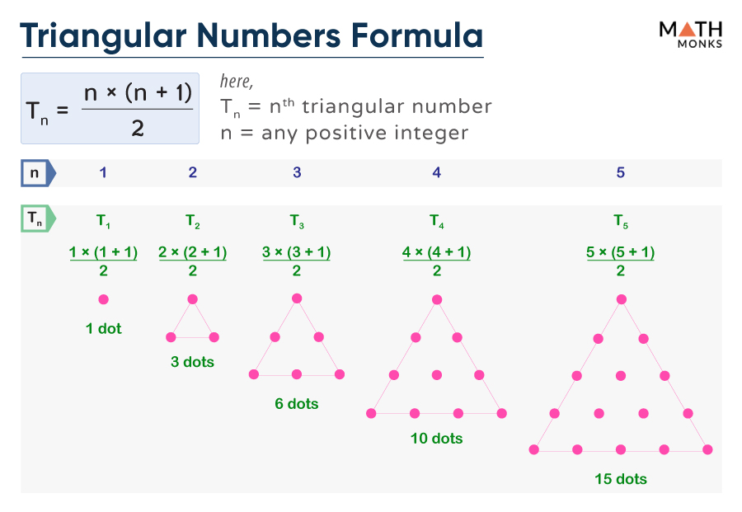
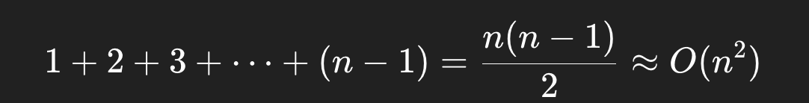
Math
The pattern is the triangular numbers (sum of 1 through n-1).
(n−1)+(n−2)+⋯+1
So for n=100:
(100×99)/2=4950
When n is large, the n² part dominates (subtracting n or dividing by 2 doesn’t matter as much).
So we write it as O(n²).
Intuition: if you double n, the work grows about four times.

Slide 13
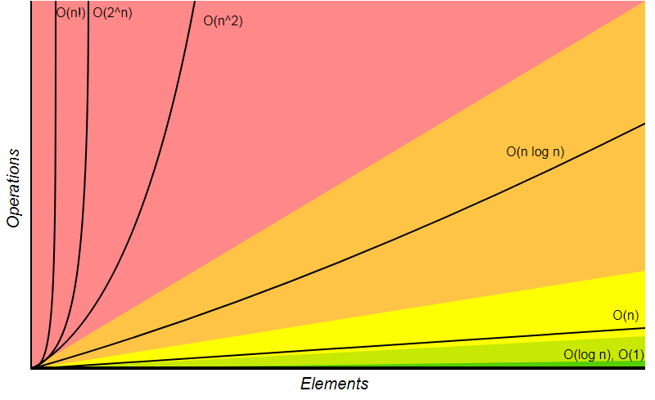
Quadratic
O(n²)
Starting to get slow
1 input takes 1 second, 10 input takes 100 second, 100 inputs take 10,000 second
Examples
Selection sort
Bubble Sort
Insertion Sort
Quick Sort

Slide 14
Analyze Insertion Sort
Download Analyzing Insertion and Selection Sort
You will submit at the end of class.

Slide 15
Algorithm Analysis Purpose
Algorithm Analysis is a Topic in computer science where you examine the efficiency of algorithms
Possible to have several algorithms that are a solution to a problem
Need to compare the efficiency of algorithms to select the best algorithm
Understanding algorithm efficiency is also important when building data structures
Data structure built correctly
Efficient use of both CPU and memory
Can be reused in many different applications
Data structure built incorrectly
Problematic in terms of CPU and memory
Not reusable
You will focus on CPU (time) efficiency now; memory and other resources are covered in later courses.

Slide 16
Best, Worst and Average Cases
An algorithm’s execution time can vary depending on the input
Can analyze 3 cases:
Best-case input
Input that results in shortest execution time
Of little interest because it does not represent typical behavior
Average-case input
Average amount of time among all possible inputs of the same size
Often represents typical behavior
In most cases difficult to compute
Worst-case input
Input that results in the longest execution time
Easier to perform than average
Useful because we know algorithm won’t be slower than this!
Analysis is generally conducted for worse case

Slide 17
Comparison
Algorithm | Best Case | Worst Case | Average Case | Notes
Selection Sort | ❌ O(n²) | ❌ O(n²) | ❌ O(n²) | Always scans the whole unsorted part; predictable but inefficient
Insertion Sort | ✅ O(n) | ❌ O(n²) | ⚠ O(n²) | Adaptive: very fast if sorted/nearly sorted
Bubble Sort | ✅ O(n)* | ❌ O(n²) | ❌ O(n²) | With early-exit optimization best case is O(n); still quadratic worst/average
Selection is always ❌.
Insertion can sometimes be ✅.
Bubble looks similar to Insertion, but is slower in practice.

Slide 18
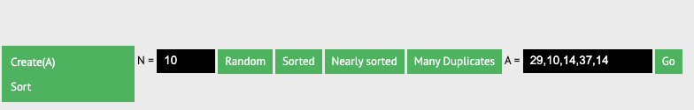
Performance
Best: Insertion Sort (especially for small/nearly sorted arrays).
Worst: Bubble Sort (due to excessive swaps).
Selection Sort was in the middle but does unnecessary swaps, making it slower than Insertion Sort.
💡 For small inputs, all three were "about the same," but for large inputs, the differences became extreme.
Explore the above sorting algorithms and try different data sets https://visualgo.net/en/sorting

Slide 19
Insertion Sort
How it works: Inserts each element into the correct position within the sorted part of the array.
Step-by-step:
Start with the first element as sorted.
Take the next element and shift it left until it’s in the correct position.
Repeat for all elements.
Efficiency:
Best Case (): If the array is already sorted, only one comparison per element.
n−1 comparisons (O(n))
Worst Case (): If the array is sorted in reverse order, each element moves across the entire sorted part.
n(n−1)/2 comparisons (O(n²))

Slide 20
BubbleSort
How it works: Swaps adjacent elements until the array is fully sorted.
Step-by-step:
Compare each pair of adjacent elements and swap if they are in the wrong order.
Pass through the list multiple times until no swaps are needed.
Each pass moves the largest element to its correct position.
Efficiency:
Best Case (): If already sorted, only one pass is needed.
Worst Case (): Requires multiple swaps per element.
Rarely used due to inefficiency.
Even with the early-exit improvement, Bubble Sort is still O(n²) in the worst case.

Slide 21
Summary
Algorithm Analysis is a Topic in computer science where you examine the efficiency of algorithms
Insertion Sort was generally the fastest, especially for small or nearly sorted arrays.
It performed better than Selection Sort because it avoids unnecessary swaps and shifts elements instead.
Bubble Sort is the slowest in almost all cases.
It performs a large number of unnecessary swaps, even when the list is nearly sorted.
The ranking was mostly consistent: Insertion Sort was fastest, Selection Sort was in the middle, and Bubble Sort was the slowest.
However, for small input sizes, the difference between the three algorithms was not very noticeable.
For larger input sizes, sorting times increased significantly.

